Slide 1

THE HEADING TITLE IS EDITABLE
OUR WEEKLY NEWS
THIS ROW IS EDITABLE
MRS. CLARK
SEPTEMBER 21-25
TEXT
TEXT
TEXT
BOXES CAN BE MOVED OR RE-SIZED.
TEXT
CLIPART IS NOT EDITABLE

Slide 2

NEWSLETTER
MRS. CLARK
SEPTEMBER 21-25
TEXT
TEXT
TEXT
TEXT

Slide 3

NEWSLETTER
MRS. CLARK
SEPTEMBER 21-25
TEXT
TEXT
TEXT
TEXT

Slide 4

OUR WEEKLY NEWS
MRS. CLARK
SEPTEMBER 21-25
TEXT
TEXT
TEXT
TEXT

Slide 5

NEWSLETTER
MRS. CLARK
SEPTEMBER 21-25
TEXT
TEXT
TEXT
TEXT

Slide 6

NEWSLETTER
MRS. CLARK
SEPTEMBER 21-25
TEXT
TEXT
TEXT
TEXT

Slide 7

NEWSLETTER
MRS. CLARK
SEPTEMBER 21-25
TEXT
TEXT
TEXT
TEXT

Slide 8
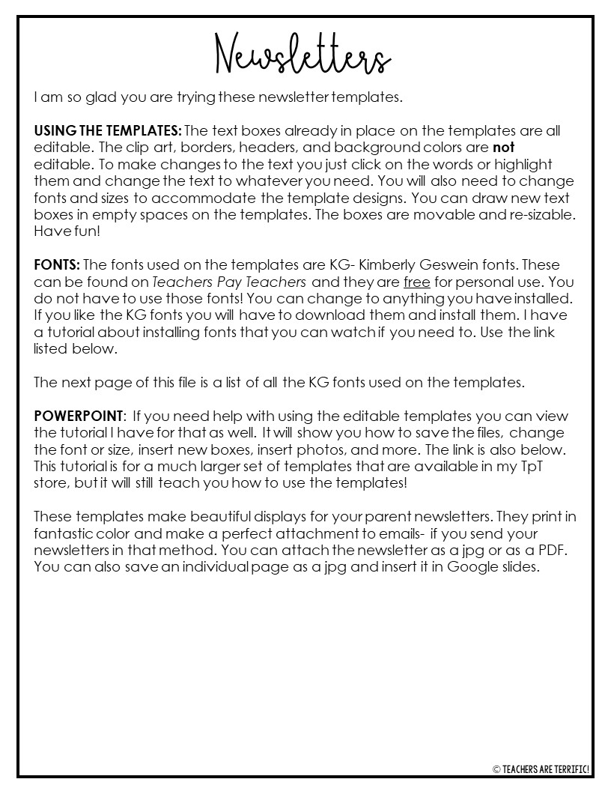
THESE LINKS ARE CLICKABLE!
How to Add Fonts:
http://bit.ly/Addingfonts
Using Newsletters:
http://bit.ly/EditingNewsletters

Slide 9
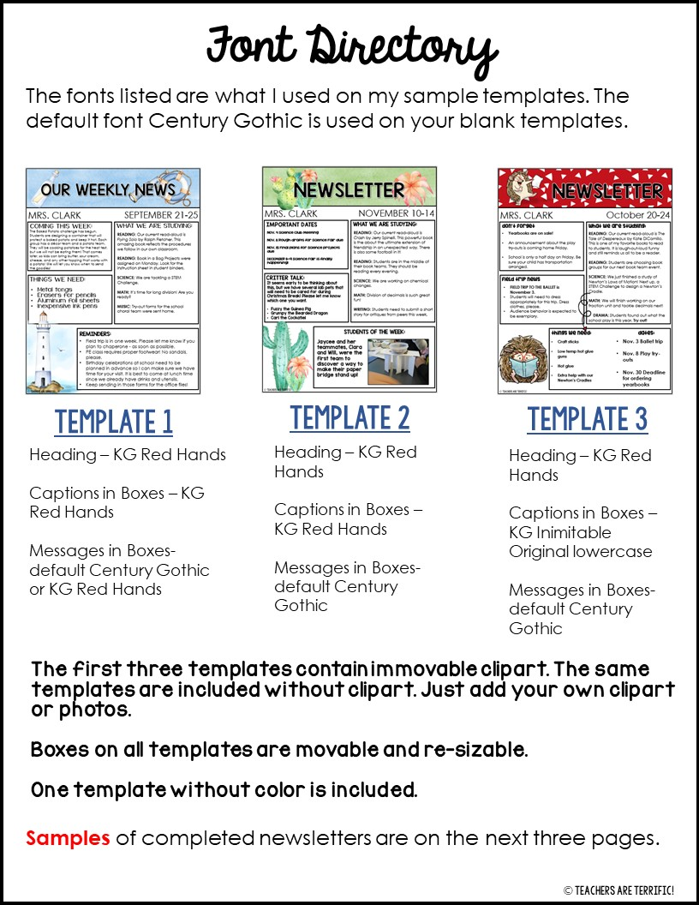

Slide 10
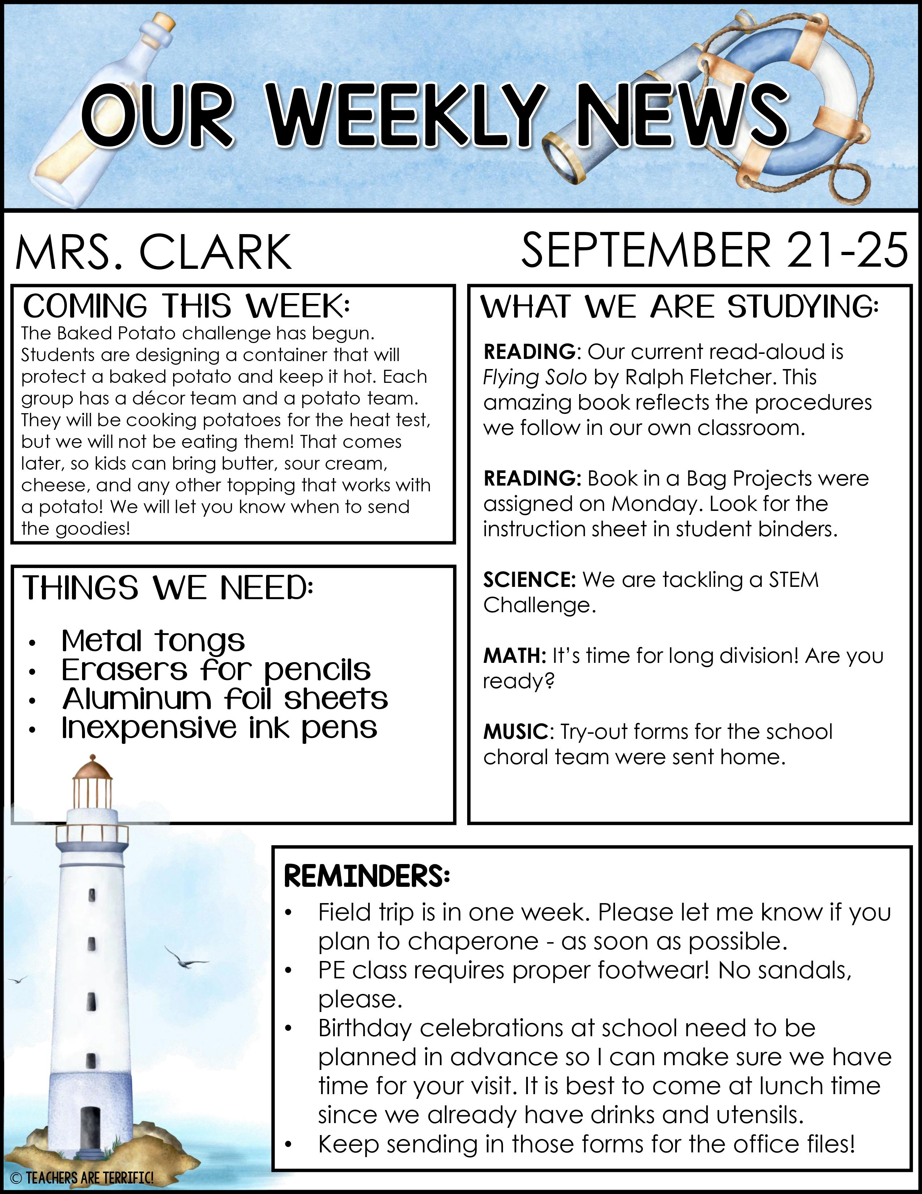

Slide 11
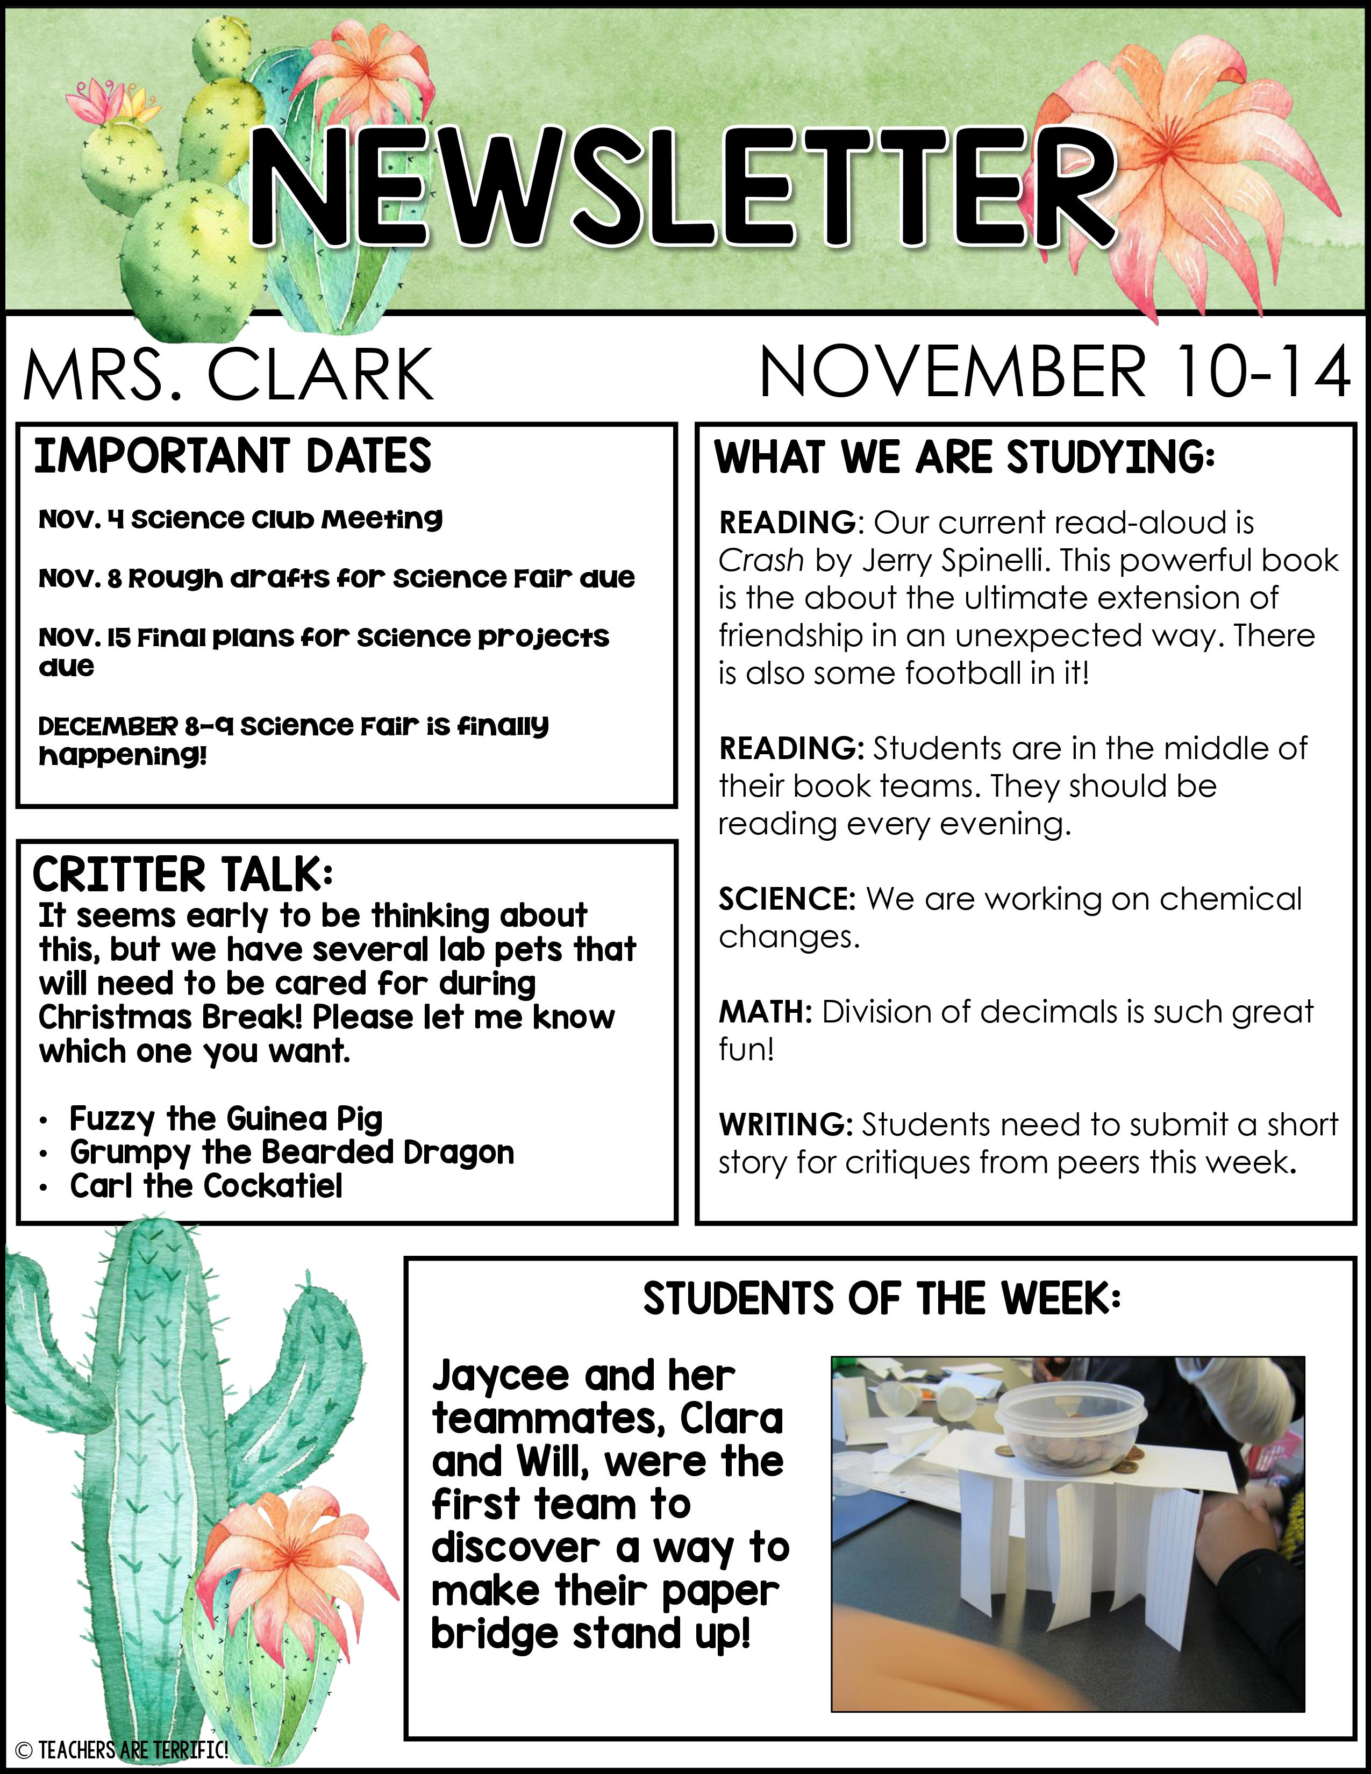

Slide 12
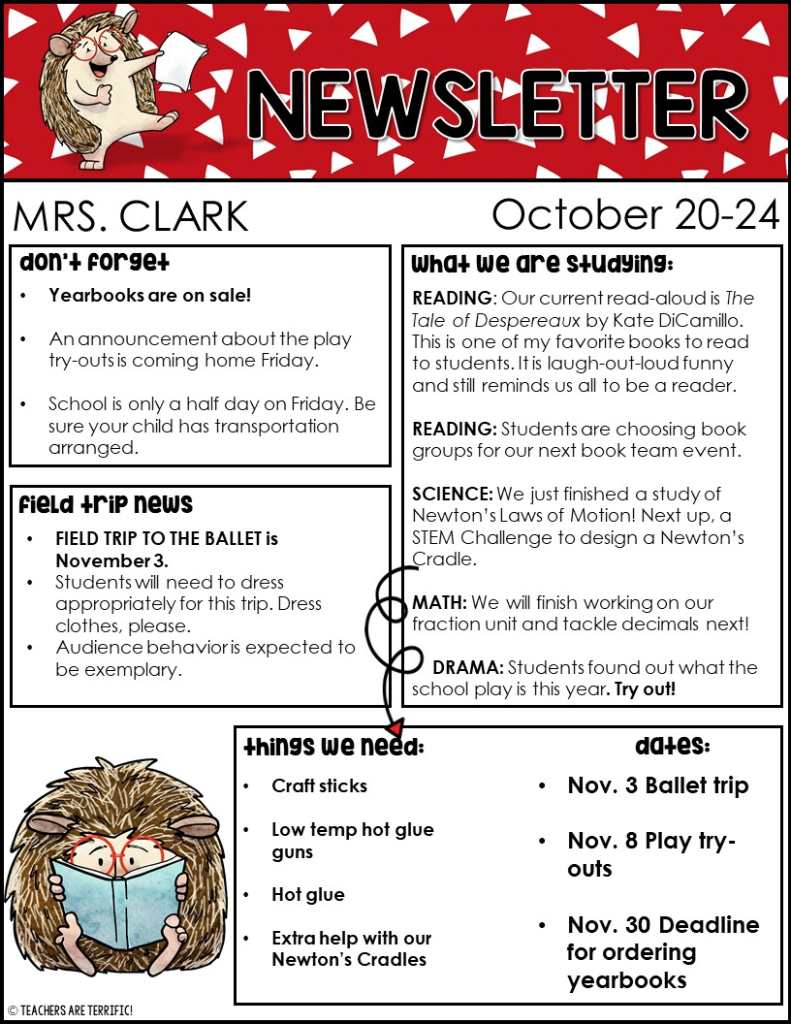

Slide 13


